Slide 1
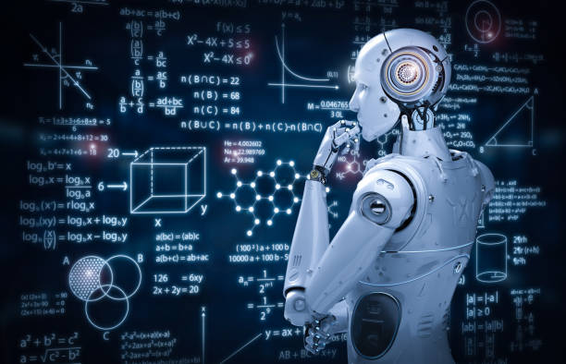
Lip To Speech…
Deep Learning
Afeef 2AB19CS037
Nayil 2AB19CS008
Guide: Prof. Rizwan Sheikh

Slide 2
Content
Company Profile
Introduction
Problem Statement
Objective
Flow Chart/ Architecture
Challenges
Maximizing Online Tools and Resources for a Successful Internship Experience
How Lip To Speech Synthesis Works
Software and Hardware requirements
References

Slide 3
COMPANY PROFILE
Varcons Technologies Pvt Ltd, was incorporated with a goal, “To provide high quality and optimal Technological Solutions to business requirements to their clients”.
Varcons Technologies Pvt Ltd is a Technology Organization providing solutions for all web design and development, MYSQL, PYTHON Programming, HTML, CSS, ASP.NET and LINQ. Meeting the ever increasing automation requirements, Varcons Technologies Pvt Ltd specialize in ERP, Connectivity, SEO Services, Conference Management, effective web promotion and tailor-made software products, designing solutions best suiting clients requirements.

Slide 4
Products of Varcons Technologies
Android Apps
It is the process by which new applications are created for devices running the Android operating system. Applications are usually developed in Java and/or Kotlin.
Web Application
It is a client–server computer program in which the client (including the user interface and client- side logic) runs in a web browser.
Web design
It is encompasses many different skills and disciplines in the production and maintenance of websites.

Slide 5
Services provided by Varcons Technologies
Core Java and Advanced Java
Web services and development
Dot Net Framework
Python
Selenium Testing
Conference / Event Management Service
Academic Project Guidance
On Job Training
Software Train

Slide 6
Introduction
We as humans pay high attention to lip movements to “visually hear” the speech in highly noisy environments. Facial actions, specifically the lip movements, thus reveal a useful amount of speech information.
Our project motivation is to use the same thing as humans to create the speech based on the lip movements of the speaker in the video.

Slide 7
Problem Statement
Learning the speech pattern of the speaker based on lip movement using CNN

Slide 8
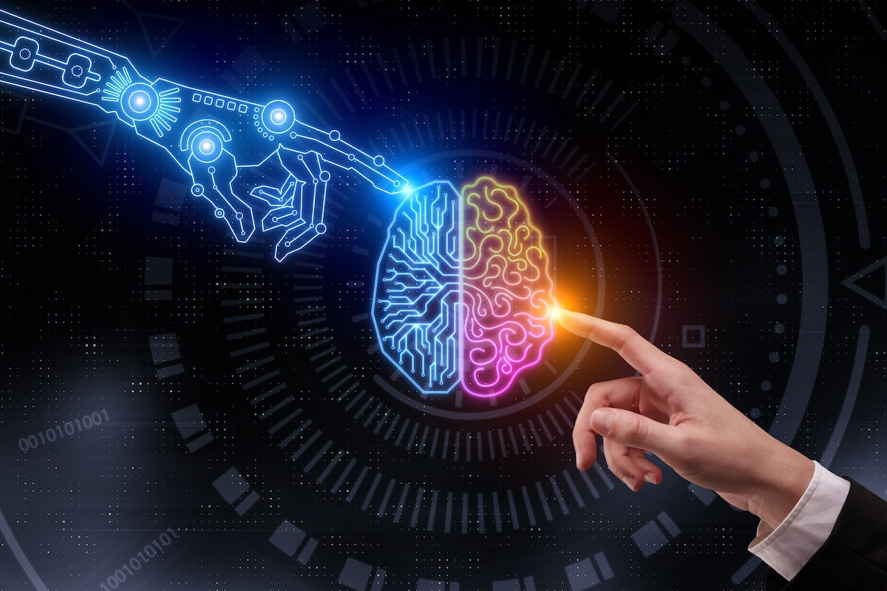
Objectives
Learning to generate natural speech given only the lip movements of a speaker.
The project will contain an application where user would be able to add the audio to an audio-less video based on the lip movement of the speaker.

Slide 9
Lip To Speech Flowchart
Face Detection
Input video
Start
Lip Extraction
Speech recognition
End
Output video with AI generated speech

Slide 10
Web Application Flowchart
Users uploads
video without audio
Is Video valid?
Initiate Flutter
App
Yes
No
Server generates audio based on the lip movements in the video
Invalid Video Format
Video with AI generated audio
End

Slide 11
Challenges
Lack of recognition: Despite doing good work, interns may not always receive the recognition they deserve, which can be discouraging.
It’s our first job kind of experience. Reaching late for classes and late submissions of assignments was tolerated by our college professors. But in a professional workspace it isn’t acceptable and hence managing time can be really difficult for us.
Balancing work, academics, and personal life can be challenging, especially for interns who are still figuring out how to manage their time effectively in a professional workspace.
We accepted an internship thinking that there won’t be much pressure and the compensation would be sufficient for it. But after we actually start, we realize the pay is far lesser than the work deserves.
Communication is one of those internship challenges that can actually hinder our internship time.

Slide 12
Making the Most of Online Resources: Our Journey to Completing a Challenging Task
W3Schools is a popular online resource for learning web development, and we used it to learn various concepts and techniques related to web development.
YouTube is another great resource that we used to watch video tutorials and learn from experts in the field.
Online forums like Stack Overflow were also helpful in troubleshooting issues and finding solutions to problems we encountered during our work.
We also used online tools like code editors, color palette generators, and image compression tools to streamline our workflow and improve our productivity.
By using these resources, we were able to learn new skills, solve problems more efficiently, and ultimately complete our task successfully.

Slide 13
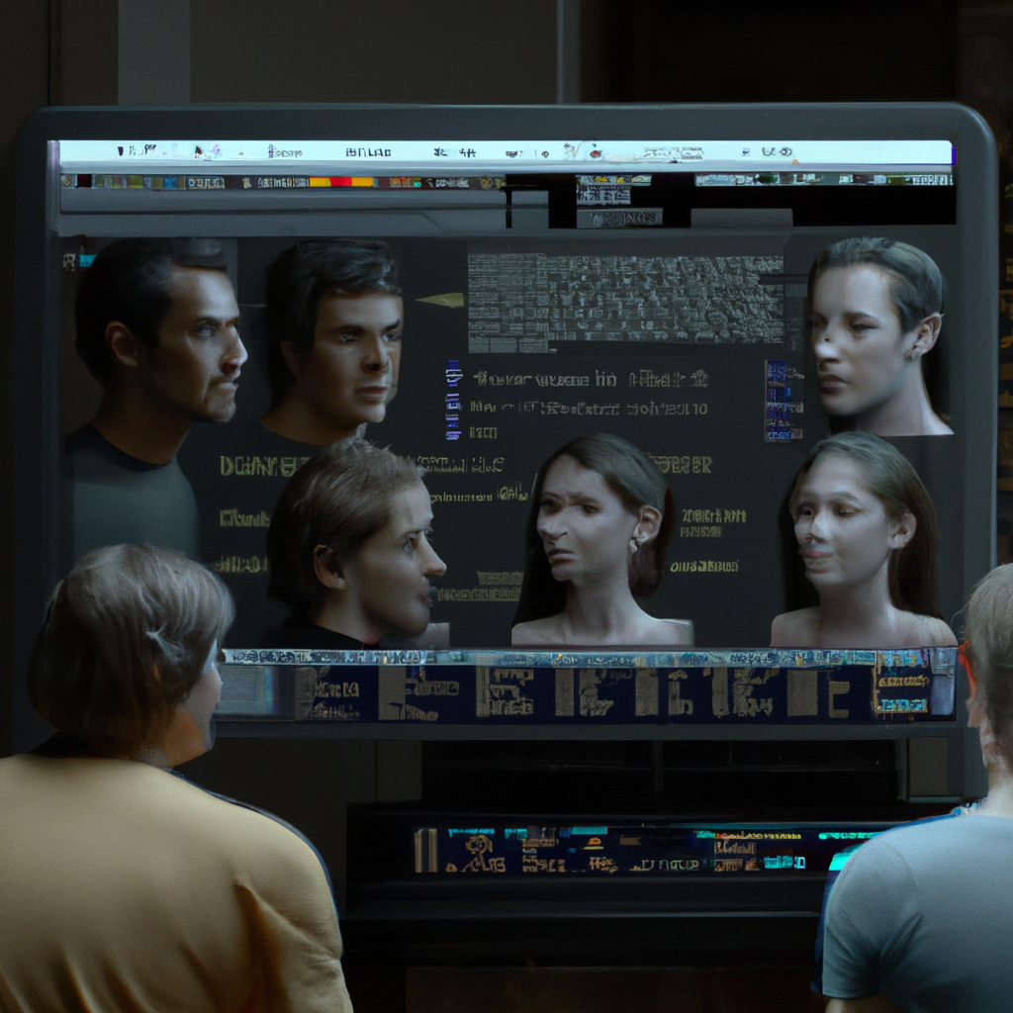
How Lip To Speech Synthesis works
Lip To speech synthesis relies on a combination of machine learning and artificial intelligence to create realistic speech. The technology analyzes the movement of the lips and uses this information to generate speech that matches the lip movements.
The system is trained using large datasets of video footage and corresponding audio files. Through this training process, the system learns to recognize patterns in lip movements and associate them with specific sounds and words.

Slide 14
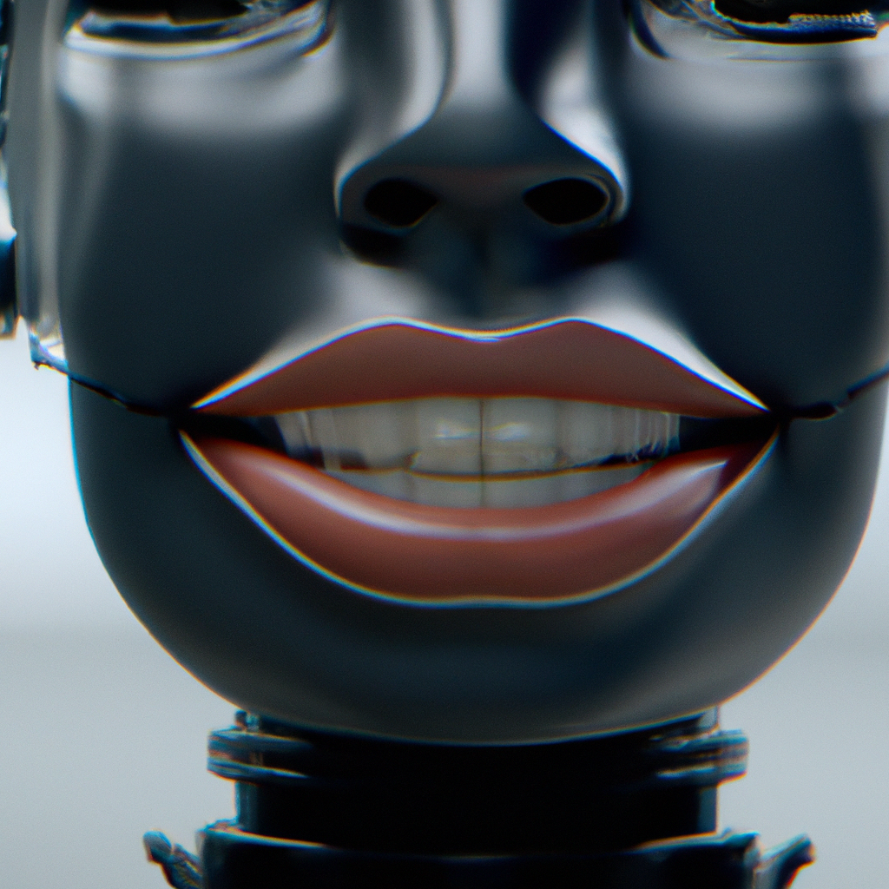
Applications of Lip To Speech Synthesis
Lip To speech synthesis has numerous applications in various fields. One of the most promising applications is in the field of assistive technology. The technology can be used to help people with speech impairments communicate more effectively.
Another application of Lip To speech synthesis is in the entertainment industry. The technology can be used to create more realistic animated characters and improve the quality of dubbed films and TV shows.

Slide 15
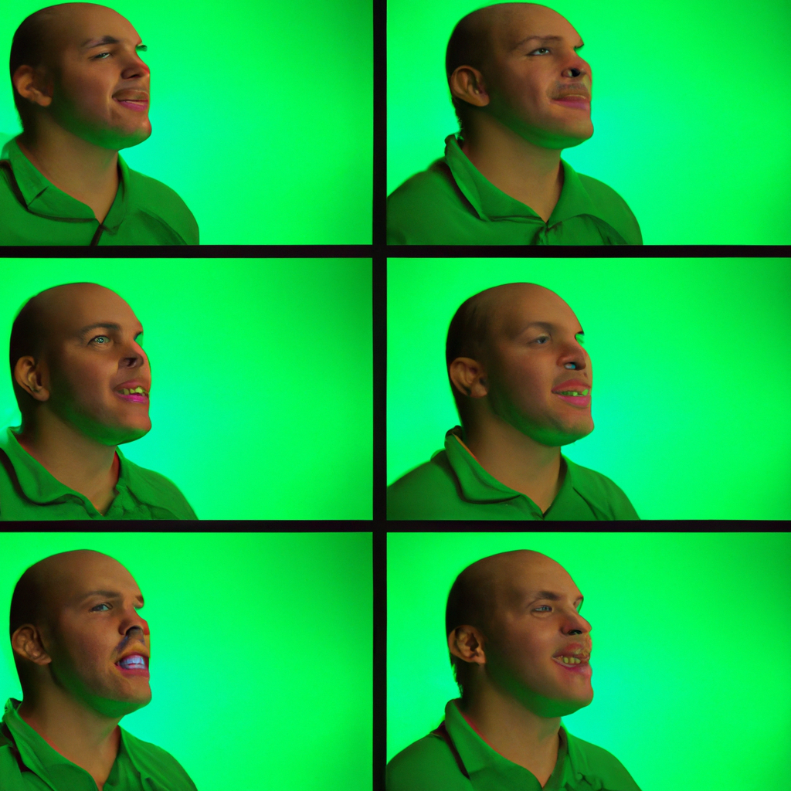
Challenges and Limitations of Lip To Speech Synthesis
While LipTo speech synthesis has many benefits, there are also several challenges and limitations associated with the technology. One major challenge is the need for high-quality video footage. The technology requires clear, well-lit video footage in order to accurately track lip movements.
Another limitation of LipTo speech synthesis is that it currently only works for English language speech. The technology will need to be adapted for other languages in order to be widely adopted around the world.

Slide 16
Requirements
Software
Hardware
Frameworks:
Django
Flutter
Tensorflow
dlib
Programming Languages:
Python 3.10.x
Dart
Tools:
Visual Studio Code,
Jupyter Notebook,
Operating System:
Windows Native - Windows 7 or higher (64-bit)
Intel Core i3 @3.7GHz or higher .
8GB of RAM
NVIDIA® GPU card with CUDA® architectures 3.5, 5.0, 6.0, 7.0, 7.5, 8.0 and higher.

Slide 17
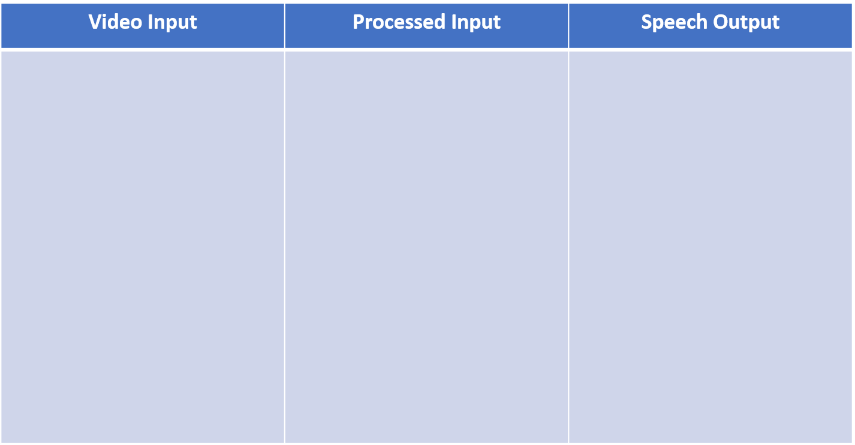
Architecture

Slide 18

Ground Truth
Predicted Value

Slide 19
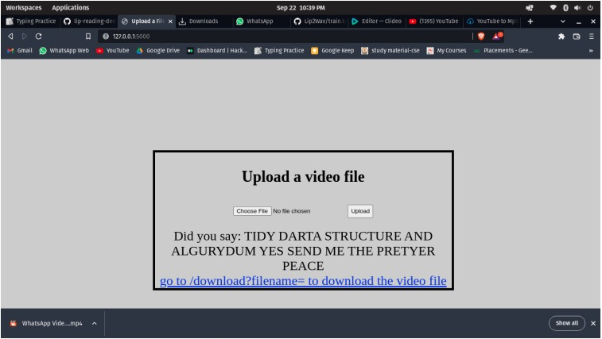
Front End

Slide 20
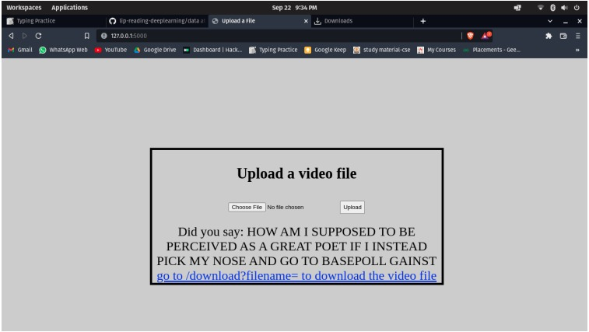
User Interface

Slide 21
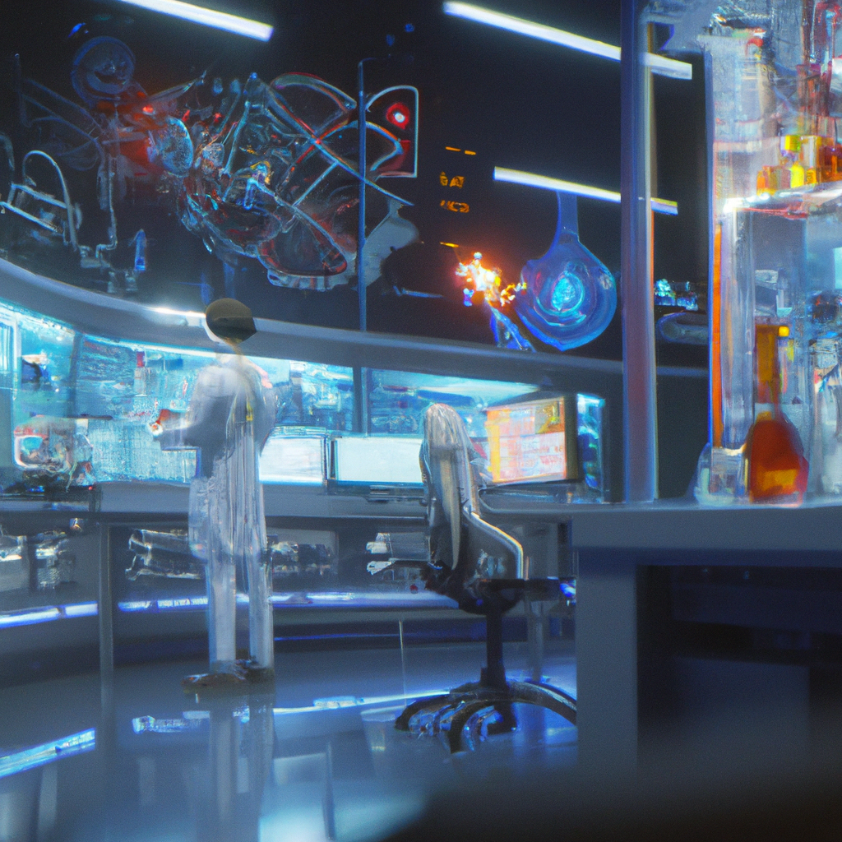
Future Developments in Lip To Speech Synthesis
Despite its current limitations, LipTo speech synthesis has significant potential for future development. One area of focus is improving the accuracy of the technology. Researchers are working to develop more advanced algorithms that can better analyze and interpret lip movements.
Another area of development is expanding the capabilities of the technology to work with other languages and dialects. As the technology continues to improve, it has the potential to revolutionize the way we communicate with computers and other devices.

Slide 22
Skills Learnt During Internship
Supervised learning: The computer is presented with example inputs and their desired outputs, given by a "teacher", and the goal is to learn a general rule that maps inputs to outputs.
Unsupervised learning: No labels are given to the learning algorithm, leaving it on its own to find structure in its input. Unsupervised learning can be a goal in itself (discovering hidden patterns in data) or a means towards an end (feature learning).
Reinforcement learning: A computer program interacts with a dynamic environment in which it must perform a certain goal (such as driving a vehicle or playing a game against an opponent). As it navigates its problem space, the program is provided feedback that's analogous to rewards, which it tries to maximize.
Data Modeling and Evaluation: Data modeling involves understanding the underlying structure of the data and then finding patterns that are not obvious to the naked eye. The data needs to be evaluated using an algorithm that is suitable for the data. For example, the type of machine learning algorithms to use such as regression, classification, clustering, dimension reduction, etc. depends on the data

Slide 23
There are several Soft Skills as well. Few of them are: -
Teamwork
Problem Solving Skills
Work Ethics
Adaptability Skills
Communication skills
Responsibility
Time Management

Slide 24
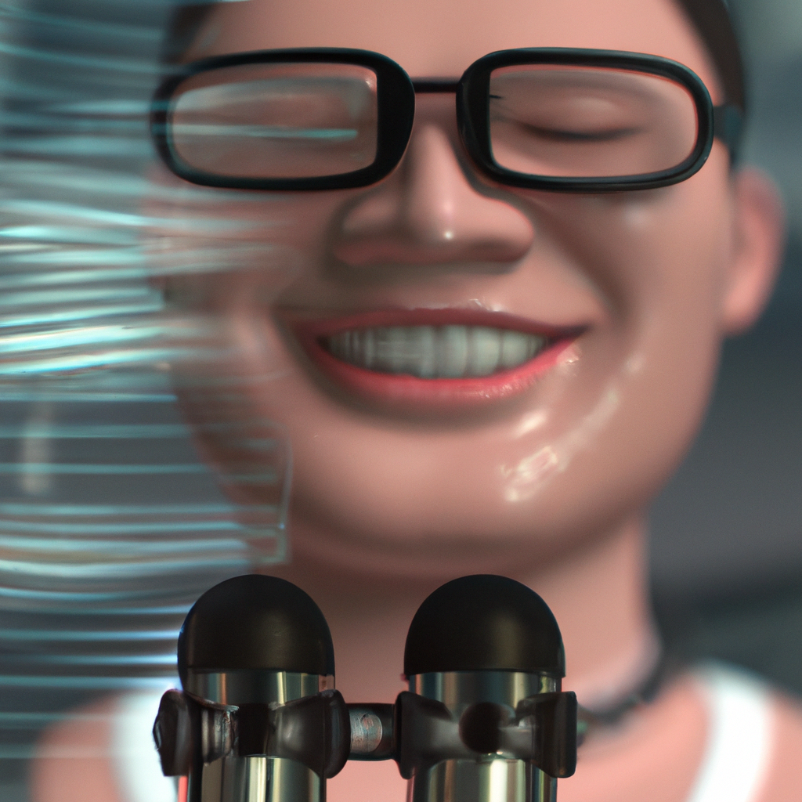
Conclusion
In conclusion, LipTo Speech is a groundbreaking technology that has the potential to greatly improve the quality of life for individuals with speech impairments. The technology is highly effective, portable, and easy to use, making it accessible to a wide range of individuals.
While there are some challenges and limitations associated with the technology, ongoing research and development efforts are likely to address these issues and further enhance the usability and effectiveness of LipTo Speech in the future.

Slide 25
References
Triantafyllos Afouras, Joon Son Chung, and Andrew Zisserman.The conversation: Deep audio-visual speech enhancement. arXiv preprint arXiv:1804.04121, 2018.
Ariel Ephrat and Shmuel Peleg. Vid2speech: speech reconstruction from silent video. In 2017 IEEE International Conference on Acoustics, Speech and Signal Processing (ICASSP), pages 5095–5099. IEEE, 2017.
A. Torfi, S. M. Iranmanesh, N. Nasrabadi and J. Dawson, "3D Convolutional Neural Networks for Cross Audio-Visual Matching Recognition," in IEEE Access, vol. 5, pp. 22081-22091, 2017, doi: 10.1109/ACCESS.2017.2761539.
K. R. Prajwal, R. Mukhopadhyay, V. P. Namboodiri and C. V. Jawahar, "Learning Individual Speaking Styles for Accurate Lip to Speech Synthesis," 2020 IEEE/CVF Conference on Computer Vision and Pattern Recognition (CVPR), 2020, pp. 13793-13802, doi: 10.1109/CVPR42600.2020.01381

